Slide 1
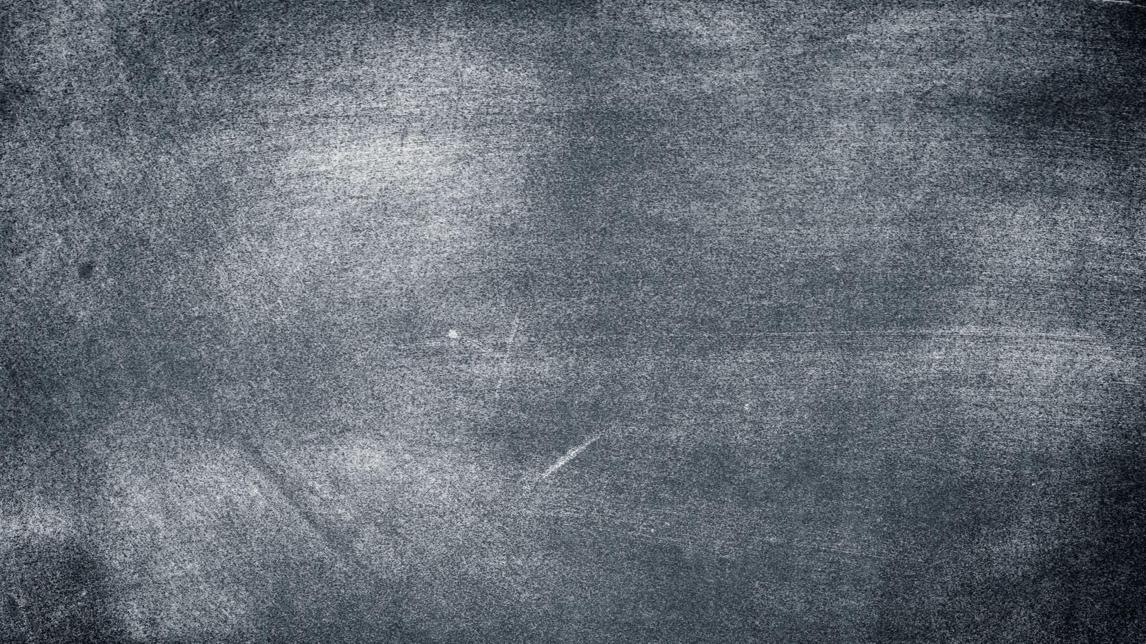
Mask R-CNN Explanation
Weicong Feng

Slide 2
Outline
Basic concepts and background knowledge
R-CNN Family
Mask R-CNN Architecture
Ablation Experiments
Notes:
Computer vision is one of major topic in machine learning
a wide range of applications, for example auto-drive, medical image analysis
2 purposes: introduce a fantastic, popular cv architecture – mask rcnn
help to finish our final project

Slide 3
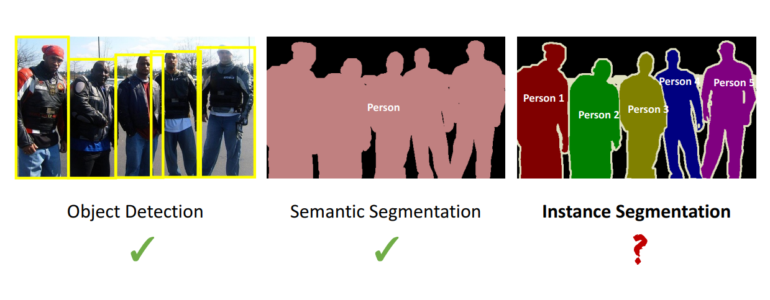
Instance Segmentation
Video Demo: https://www.youtube.com/watch?v=OOT3UIXZztE&t=410s

Slide 4

Basic concepts in CV
IoU (Intersection over Union)
AP (Average Precision)
AP50, AP75, or AP@[0.5:0.95]?
mAP (Mean Average Precision)
averaged over different classes/categories
Kernel
Feature map
RoI (Region of Interest)
Notes:
Region of interest can be represented by the rectangle boundaries.

Slide 5
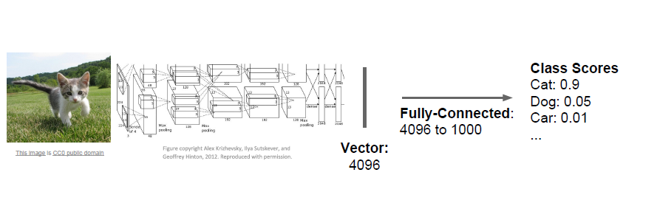
Image Classification

Slide 6
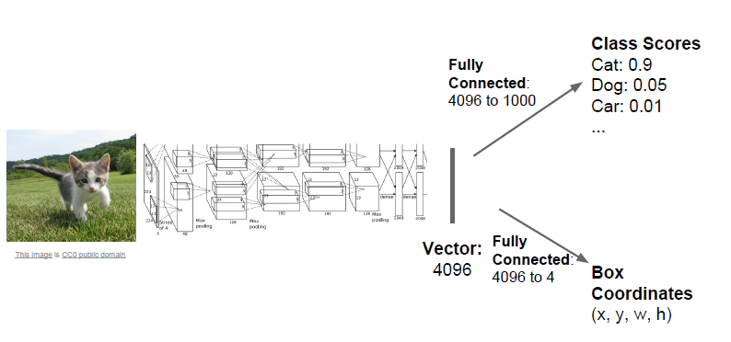
Object Detection

Slide 7
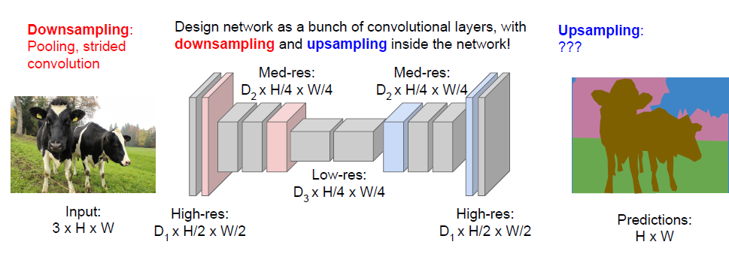
Semantic Segmentation: Fully Convolution
Notes:
Segmentation task is pixel-to-pixel, fully connected network leads to loss spatial information
We expect the output masks are same size as the input data
The reason why applying downsampling in the network is reducing computation

Slide 8
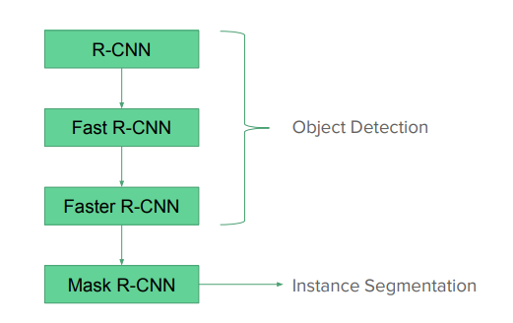
The R-CNN family
Notes:
predecessor

Slide 9
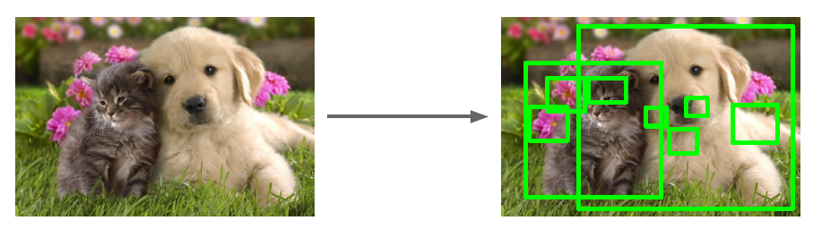
Region Proposals

Slide 10
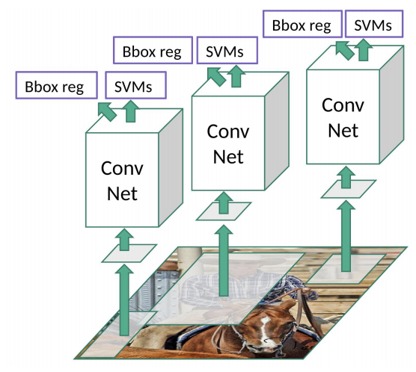
R-CNN
Notes:
Selective Search provide 2k region of interest (ROI)
Convolution network expect same input size. Otherwise, the fully connected network doesn’t work.
Warp images regions into fixed size: 227 x 227 x 3
2k regions go through the cnn to produce output features, then feed into classification and regression network, like what we mentioned before
Very slow because we need training 2k regions per image
According the report, training takes 84h in an 8 GPU machine, inference is 47s/image

Slide 11
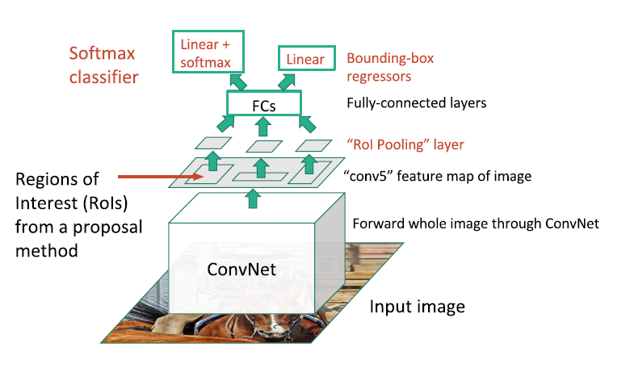
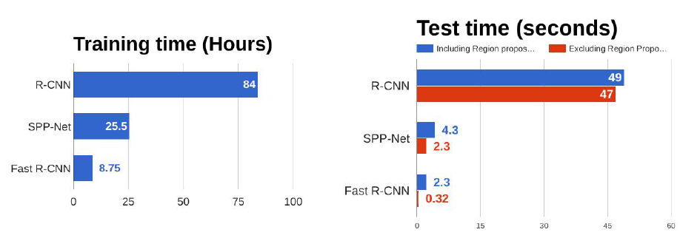
Fast R-CNN
Notes:
Rather than retrieve region of interest proposals in the inputted images, instead, Fast R-cnn retrieves proposals from feature maps
This improvement boost the performance a lot by share convolution computations

Slide 12
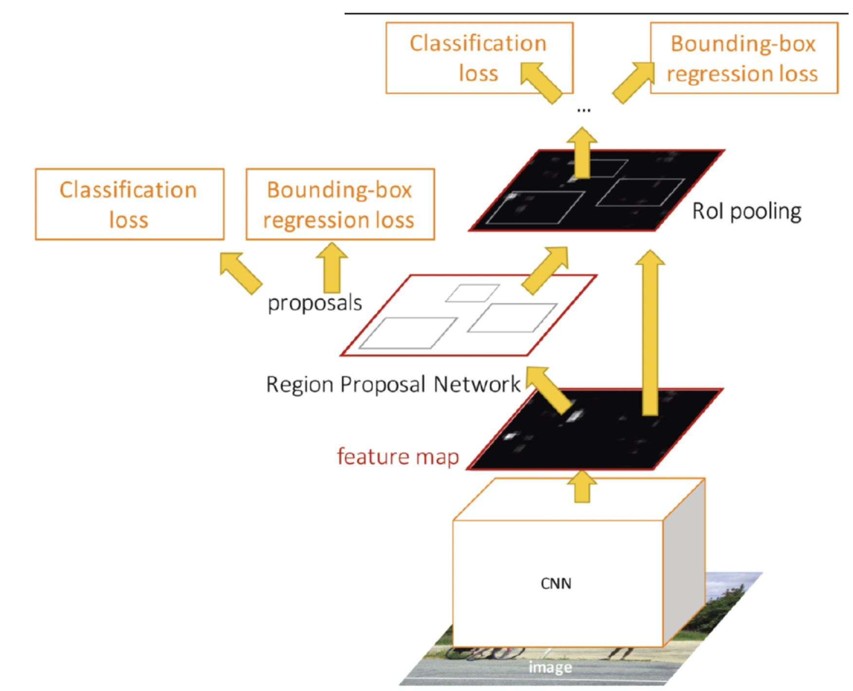
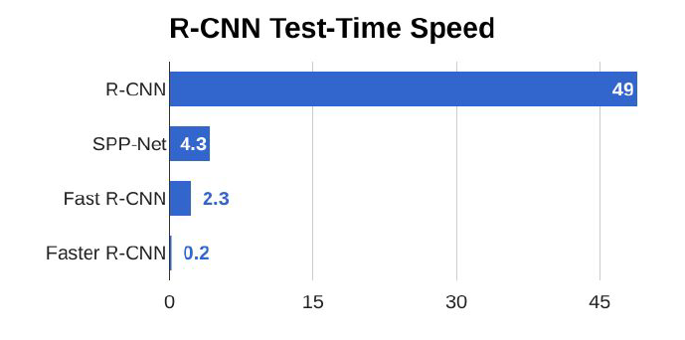
Faster R-Cnn
Notes:
In fast r-cnn model, the selective search algorithm dominates the runtime. It means the selective search become the bottleneck.
Faster r-cnn, the selective search is replaced by the RPN (region proposal network) where predicts region proposals inside the network on the top of convolution feature maps.
RPN is trainable subnetwork inside the faster rcnn network, instead of a traditional algorithm.
The runtime is significantly reduced.

Slide 13
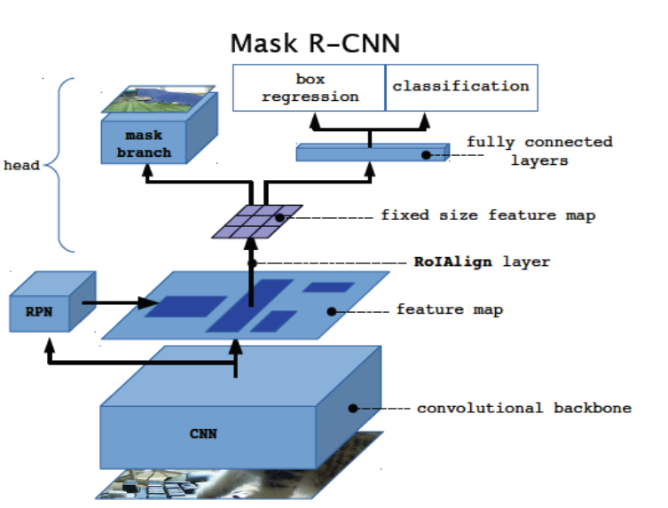
Architecture
CNN: extract feature map
RPN: produce objects proposals
Box head: classifier & box regression
Mask head: pixel mask
Notes:
Basically, the mask rcnn derived from faster rcnn.
Two branches are almost same as faster rcnn, classification and box regression
An additional branch called mask branch is added to the model

Slide 14
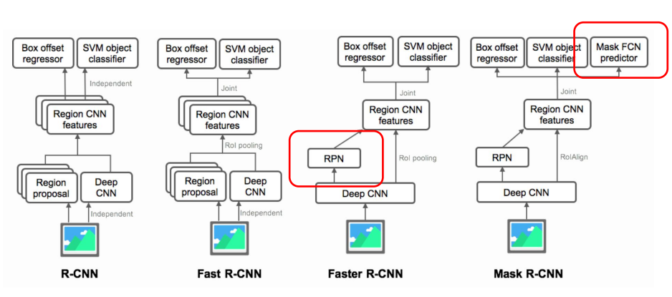
R-CNN Family

Slide 15
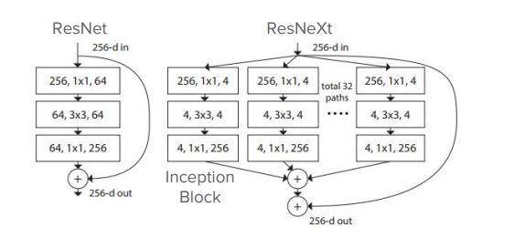
Backbone
ResNet
ResNeXt with FPN
Notes:
VGG16
ResNet50, ResNet101
Inception series
MobileNet

Slide 16
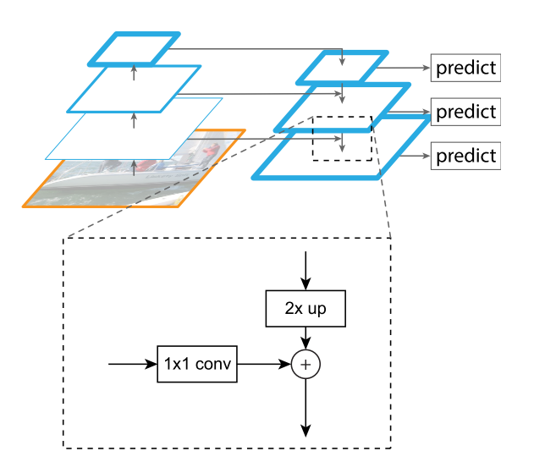
FPN, Feature Pyramid Network
Notes:
In general, the closer to the output layer, the smaller the feature map is. The small size feature map leads to difficult to detect small scale objects.
FPN address the multi-scale object detection problem
Higher level in the cnn network, more semantic value it has, lower resolution.

Slide 17
ResNet-FPN

Slide 18
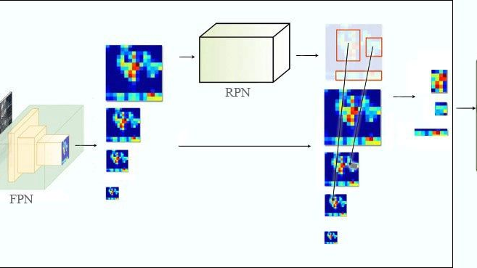
Notes:
The output of FPN will feed into RPN to produce region proposal
FPN produces feature pyramid instead of feature map
There is a suggested formular to select which feature map to cut the ROI, larger scale ROI lower resolution ratio

Slide 19
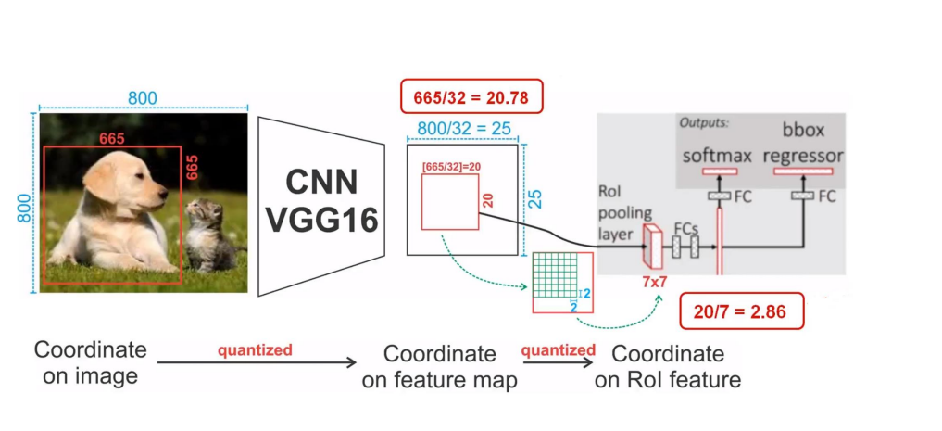
RoI Pooling
Image Source: https://www.youtube.com/watch?v=Ul25zSysk2A&inde x=1&list=PLkRkKTC6HZMxZrxnHUDYSLiPZxiUUF D2C
Notes:
Quantization is performed during RoIPool
During extracting feature maps, coordinate is divided by specific number, for example 16, 32, result in floating, and then is rounded
It leads to misalignments between RoI and the extracted features
Not impact on classification and box regression, but large negative effect on pixel-accurate masks
https://towardsdatascience.com/understanding-region-of-interest-part-1-roi-pooling-e4f5dd65bb44

Slide 20
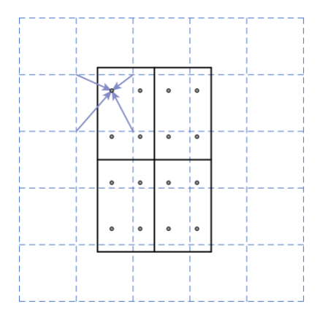
RoIAlign
Notes:
Remove quantization
4 sample for each bin and use bilinear interpolation
https://towardsdatascience.com/understanding-region-of-interest-part-2-roi-align-and-roi-warp-f795196fc193

Slide 21
Loss
L = Lclass + Lbox + Lmask

Slide 22
Implementation Detail
Train
RoI with IoU>0.5
Reshape image to shorter edge being 800 pixes
N(sampled RoIs): 64 for C4, 512 for FPN
Mini-batch: 2/GPU
160K epochs
Lr: 0.02, /10 @120K epochs
Weight decay of 0.0001, momentum of 0.9
Inference
Proposal #: 300 for C4, 1000 for FPN
Non-maximum suppression on box prediction
Mask branch apply to the highest scoring 100 detection boxes
K masks predicted, use only k-th mask
Notes:
K is the number of classes

Slide 23
Ablation Experiments
An ablation study studies the performance of an AI system by removing certain components, to understand the contribution of the component to the overall system.

Slide 24
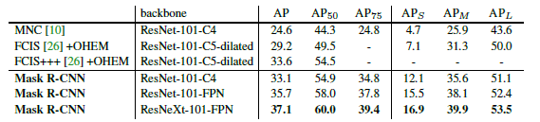
Ablation Experiments
Performance in State-of-the-art Instance Segmentation Models
Source: Mask R-CNN by Kaiming He Georgia Gkioxari Piotr Doll´ar Ross Girshick, FAIR
Notes:
Single-model result
MNC [10] and FCIS [26] are the winners of the COCO 2015 and 2016 segmentation challenges, respectively
FCIS+++ is another complex model

Slide 25
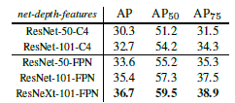
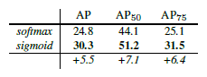
Ablation Experiments
Notes:
Backbone architecture: deeper networks do better, FPN outperforms C4 features, and ResNeXt improves on ResNet
Multinomial vs. Independent Masks(ResNet-50-C4): Decoupling via perclass binary masks (sigmoid) gives large gains over multinomial masks (softmax)

Slide 26
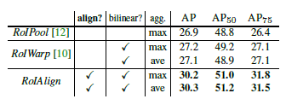
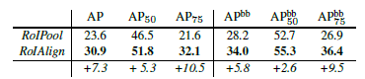
Ablation Experiments
Notes:
Mask results with various RoI layers. RoIAlign layer improves AP by 3 points and AP75 by 5 points.
ResNet-50 with stride 32. Mask-level and box-level AP using large-stride features. Misalignments are more severe than with stride-16 features

Slide 27
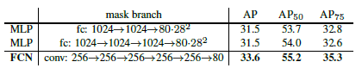
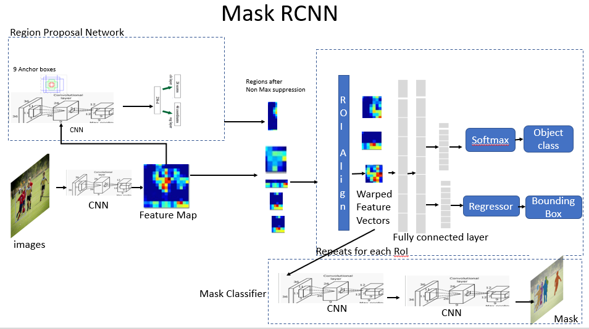
Ablation Experiments
Source: https://towardsdatascience.com/computer-vision-instance-segmentation-with-mask-r-cnn-7983502fcad1
Notes:
Mask Branch (ResNet-50-FPN): Fully convolutional networks (FCN) vs. multi-layer perceptrons (MLP, fully-connected) for mask prediction. FCNs improve results as they take advantage of explicitly encoding spatial layout.

Slide 28
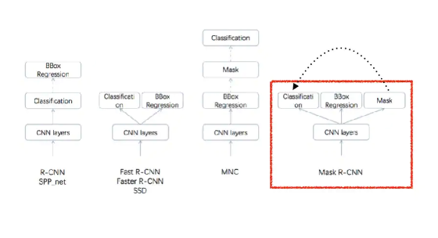
Segmentation Models
Notes:
YoLo

